Slide 1
Topic 10 Metasploit
ST251Z Ethical Hacking and Defences

Slide 2
What is Metasploit?
Metasploit provides useful information and tools for penetration testers, security researchers, and IDS signature developers. This project was created to provide information on exploit techniques and to create a functional knowledgebase for exploit developers and security professionals. The tools and information on this site are provided for legal security research and testing purposes only. Metasploit is an open source project managed by Rapid7.
- www.metasploit.com

Slide 3
Metasploit Editions
Metasploit Community Edition
Free!
Metasploit Pro
Used for security professionals who require tools to verify their findings
Command line and Web interface versions available

Slide 4
Metasploit Framework
A framework to do penetration testing as well as create additional exploit code and payloads
The Metasploit Framework consist of modules
Exploit modules
Auxiliary modules
Payload modules
Post-exploitation modules
And others

Slide 5
Metasploit modules
Exploit modules
Executes a sequence of commands to target a specific vulnerability on a system
Payload modules
The shell code that runs after an exploit successfully compromises a system
Payloads can open a Meterpreter or command shell
Meterpreter is an advanced payload

Slide 6
Metasploit modules
Auxiliary modules
Does not execute a payload
Examples include scanners, fuzzers, and denial of service attacks.
Post Exploitation modules
Gather more information or gain further access to an exploited system
Examples include hash dumps and application and service enumerators

Slide 7
Metasploit modules
New modules can be created or added to the framework
Existing modules are normally found in the directory /usr/share/metasploit-framework/modules

Slide 8
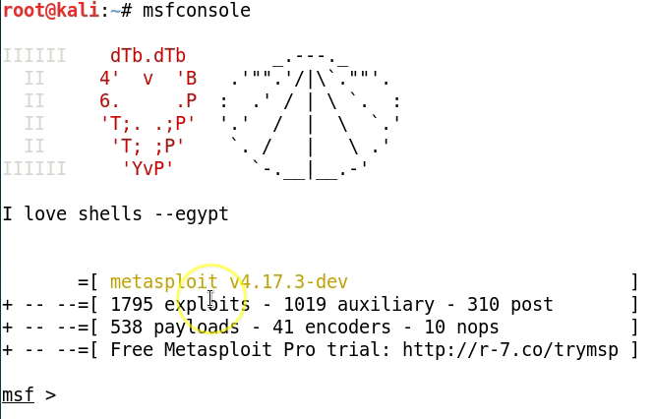
Basics of using Metasploit
Command line – msfconsole

Slide 9
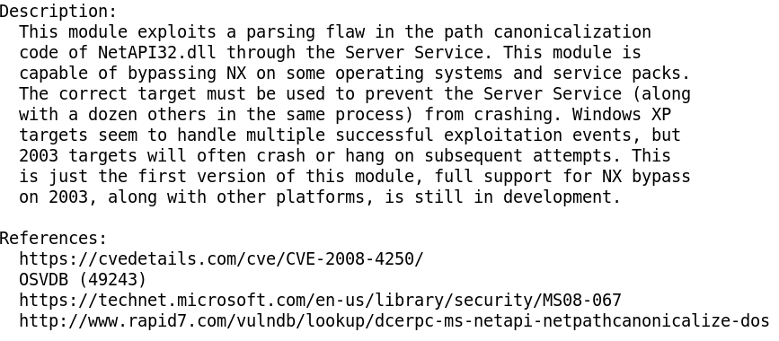

Basics of using Metasploit
Select the exploit module

Slide 10
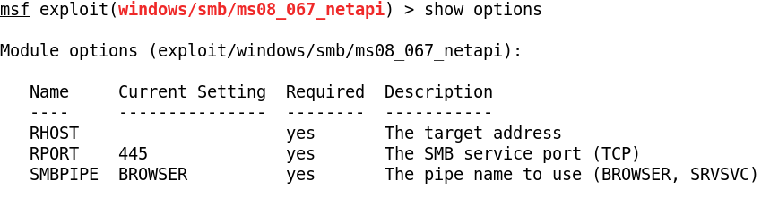
Basics of using Metasploit
View the options that can be configured for this exploit module
RHOST (Remote Host) needs to be set. This refers to the target.

Slide 11
Basics of using Metasploit
Set RHOST (Remote Host - the target)

Slide 12
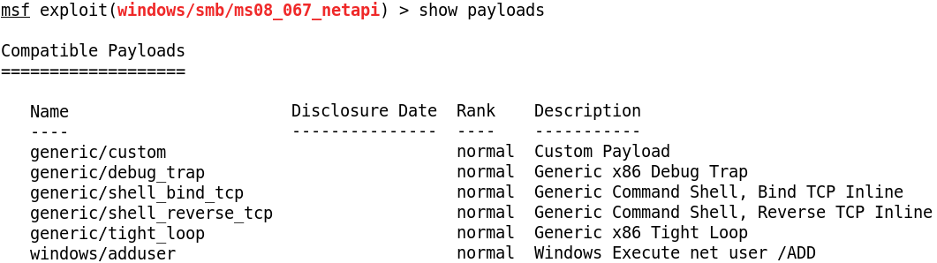
Basics of using Metasploit
View the available payloads for the exploit module
Select the payload

Slide 13
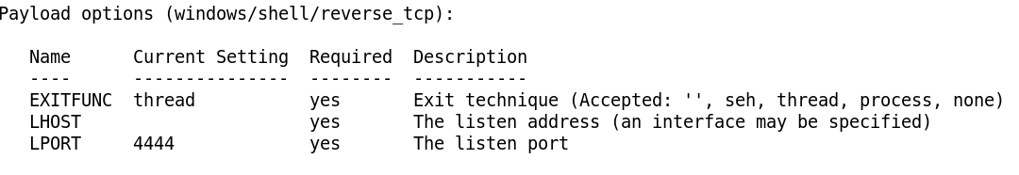
Basics of using Metasploit
View the options that can be configured for the payload module
LHOST (Listening Host) needs to be set for this payload. This refers to the tester (eg Kali).

Slide 14
Basics of using Metasploit
Set LHOST if necessary for reverse shell (Listening Host – the attacker system)

Slide 15
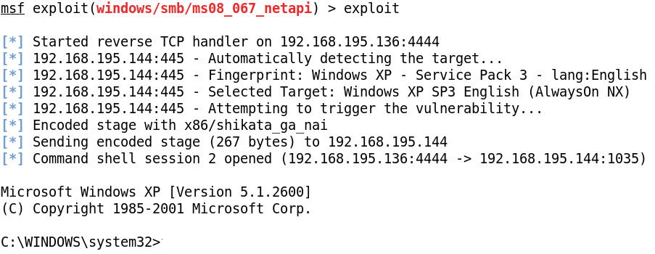
Basics of using Metasploit
Launch the exploit
In this example, the exploit is successful, and the payload returns a shell on the target system is returned. The tester is able to run commands on the target system.

Slide 16
Meterpreter
An advanced multi-function payload that provides an interactive shell.
Some functions provided by the Meterpreter shell
Download a file
Obtain the password hashes for user accounts
Monitor network traffic on target

Slide 17
Metasploit Unleashed
Useful guide to Metasploit
http://www.offensive-security.com/metasploit-unleashed

Slide 18
Exercise
Use Metasploit to exploit various vulnerabilities
Practical 10

